Slide 1
Image Cartoonization
Karthikeya Bethu
Karthik M

Slide 2
1
Table of Contents
2
3
4
5
6
Motivation
Introduction
Related work
Proposed Idea / Implementation
Conclusion
Future work

Slide 3
1
Motivation

Slide 4
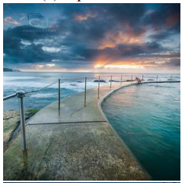
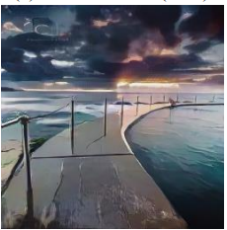
Problem Statement
Real images —> Cartoon images
[1]

Slide 5
Some use cases of Image Cartoonization
Entertainment: One of the most significant applications of image cartoonization is in the entertainment industry. Cartoonized images are widely used in animation movies, TV shows, and video games.
Social media: People use cartoonized versions of their photos as profile pictures, and cartoonized memes and posts are widely shared on social media platforms.
Education: Cartoonized images are also widely used in educational materials, such as textbooks and e-learning courses. Cartoonized images can help to simplify complex concepts and make learning more engaging and interactive.

Slide 6
2
Introduction

Slide 7
Background
Cartoons are an artistic form widely used in our daily life.
In addition to artistic interests, their applications range from publication in printed media to storytelling for children's education.
Like other forms of artworks, many famous cartoon images were created based on real-world.
However, manually re-creating real-world scenes in cartoon styles is very laborious and involves substantial artistic skills.
Each artist has his own style in creating cartoons.

Slide 8
3
Related work

Slide 9
Evolution of methods for image cartoonization
Non-photorealistic rendering (NPR)
Stylization with neural networks
(Style Transfer)
Image synthesis with GANs

Slide 10
Non-photorealistic rendering (NPR)
NPR algorithms have been developed, either automatically or semi-automatically, to mimic specific artistic styles including cartoons
However, It is difficult to capture rich artistic styles using simple mathematical formulas.
In particular, applying filtering or optimization uniformly to the entirely image does not give the high-level abstraction that an artist would normally do.

Slide 11
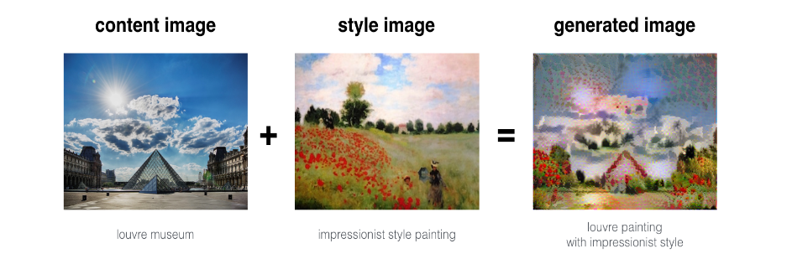
Stylization with neural networks
(Style Transfer)
Image source: https://datascience-enthusiast.com/DL/Art_Generation_with_Neural_Style_Transfer_v2.html

Slide 12
Style transfer key points
Style transfer in Convolutional Neural Networks (CNNs) is a technique for creating a new image that combines the content of one image with the style of another image.
A CNN is trained to extract features that capture the content and style of an image, using separate pre-trained networks for the content and style images.
The style features of the style image are matched with the content features of the content image to generate a new image that preserves the content of the content image while applying the style of the style image.
This is achieved by optimizing a loss function that measures the difference between the content and style features of the new image and the content and style images.
The optimization process updates the pixels of the new image to minimize this loss function until the desired level of style transfer is achieved.

Slide 13
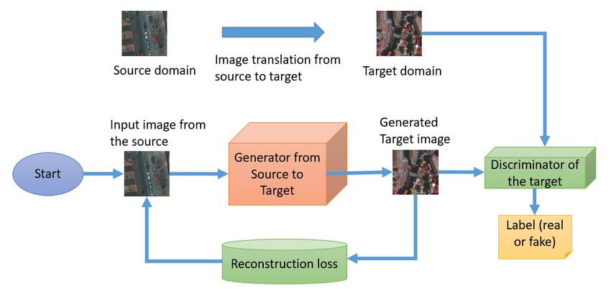
Image translation with GANs
Architecture
Generative Adversarial Networks (GANs) consist of two neural networks: a Generator and a Discriminator.
Generator: Learns to create realistic images from random noise or input images.
Discriminator: Learns to differentiate between real and generated images.

Slide 14
Image translation with GANs
Loss Functions
Adversarial loss
Adversarial loss is used in GANs to encourage the Generator to create realistic images that can fool the Discriminator. The loss is computed based on the Discriminator's classification of real and generated images. The Generator tries to minimize the adversarial loss, while the Discriminator tries to maximize it. Adversarial loss can be formulated as:
Generator loss
G_loss = -E[log(D(G(z)))]
Discriminator loss (D_loss)
D_loss = E[log(D(x))] + E[log(1 - D(G(z)))]
where G is the Generator, D is the Discriminator, z is the random noise input to the Generator, and E denotes the expectation.where x is a real image from the training dataset.
Content loss
Content loss, also known as feature loss or perceptual loss, is a type of loss function used to ensure that the generated images maintain the content and structure of the input images.
L_content = ||F(x) - F(G(x))||^2
where F(x) and F(G(x)) are the feature representations of the input image x and the generated image G(x) at a specific layer of the pre-trained model, and ||.||^2 denotes the squared Euclidean distance.

Slide 15
4
Proposed Idea

Slide 16
Implement 2 models
01
02
Style transfer
GANS
Transfer learning on pre-trained CNN
Implemed CycleGAN to to convert Real world images containing faces to Anime faces.

Slide 17
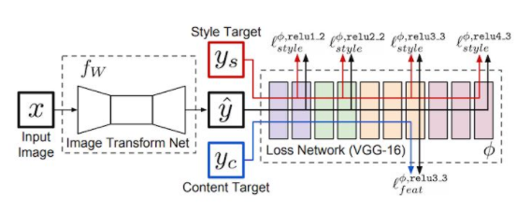
Style Transfer
Applied transfer learning on pre-trained CNN models like VGG net
It has 2 losses content loss and style loss
Image source : https://www.analyticsvidhya.com/blog/2020/10/introduction-and-implementation-to-neural-style-transfer-deep-learning/

Slide 18
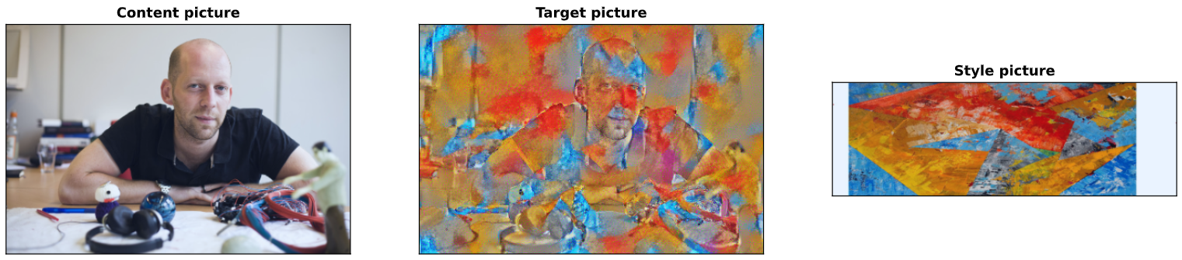
Our results for Style Transfer

Slide 19
2) GANs - CycleGAN
Paired vs. unpaired image-to-image translation:
Paired: Requires a dataset with corresponding images in both domains (e.g., input-output pairs).
Unpaired: Does not require corresponding images in both domains; learns to map between domains using separate datasets for each domain.
CycleGAN for unpaired image-to-image translation:
Consists of two Generator networks (G_A2B and G_B2A) and two Discriminator networks (D_A and D_B).
Uses cycle-consistency loss to ensure coherent image transformations between domains.

Slide 20
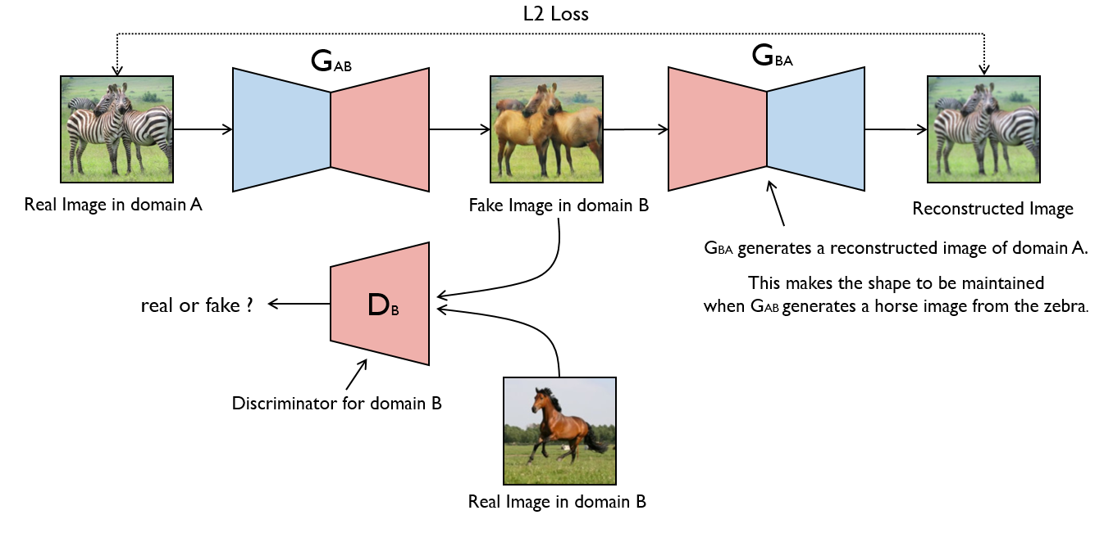
CycleGAN

Slide 21
Loss Functions for CycleGAN
Adversarial loss:
Similar to explanation in GAN slide
Cycle-consistency loss:
Cycle-consistency loss ensures that the image transformation is coherent and maintains the structure of the input image when transformed between domains and back. In the case of CycleGAN, this loss is calculated as:
L_cycle = E[||F(G(x)) - x||_1] + E[||G(F(y)) - y||_1]
where G and F are the Generator networks for the two domains, x and y are images from the respective domains, and ||.||_1 denotes the L1-norm.
Identity loss (optional):
Identity loss is an optional regularization term used to preserve color and other low-level features when the input image already belongs to the target domain. It can be formulated as:
L_identity = E[||G(y) - y||_1] + E[||F(x) - x||_1]
The total loss for the image-to-image translation GAN (e.g., CycleGAN) is a weighted sum of the three losses:
L_total = L_adv + λ_cycle * L_cycle + λ_identity * L_identity

Slide 22
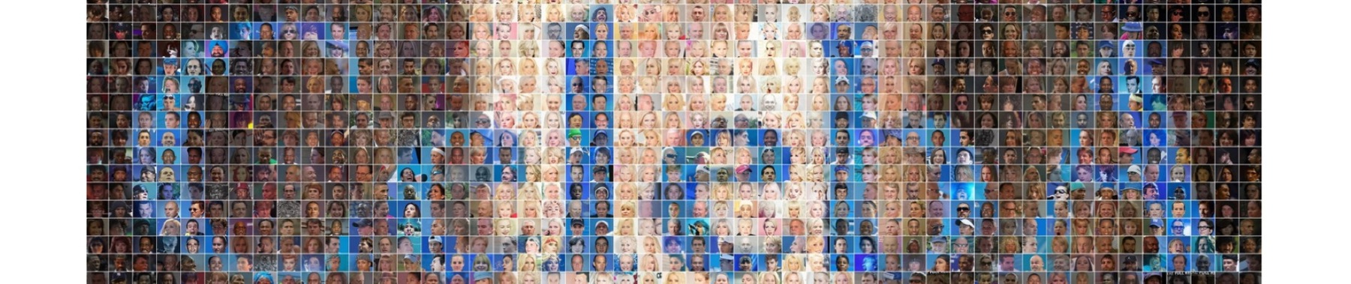
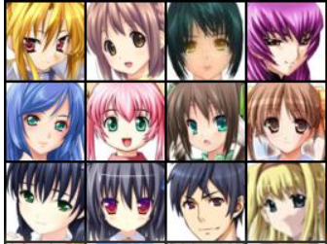
Dataset Description
CelebA
Anime Face
For Real world images
For cartoon images
This dataset contains over 200K images of celebrities
We have only used 1000 images for training model.
This dataset contains over 60K images of anime faces
We have only 1000 images for training model.

Slide 23
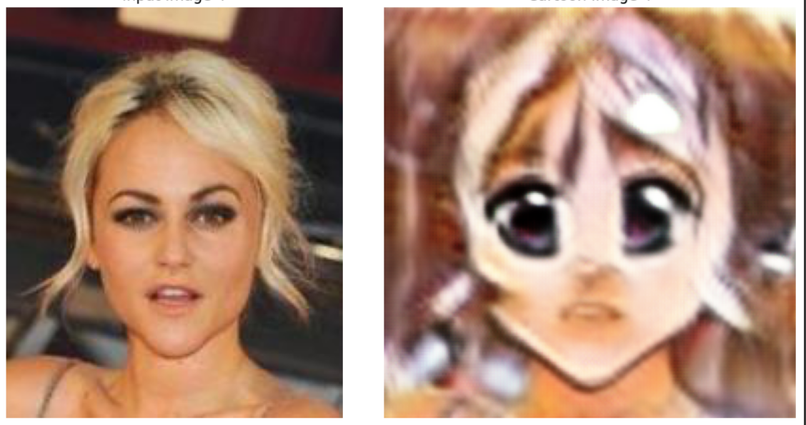
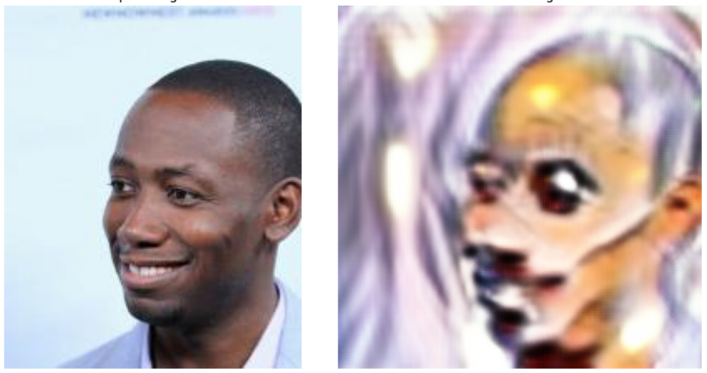
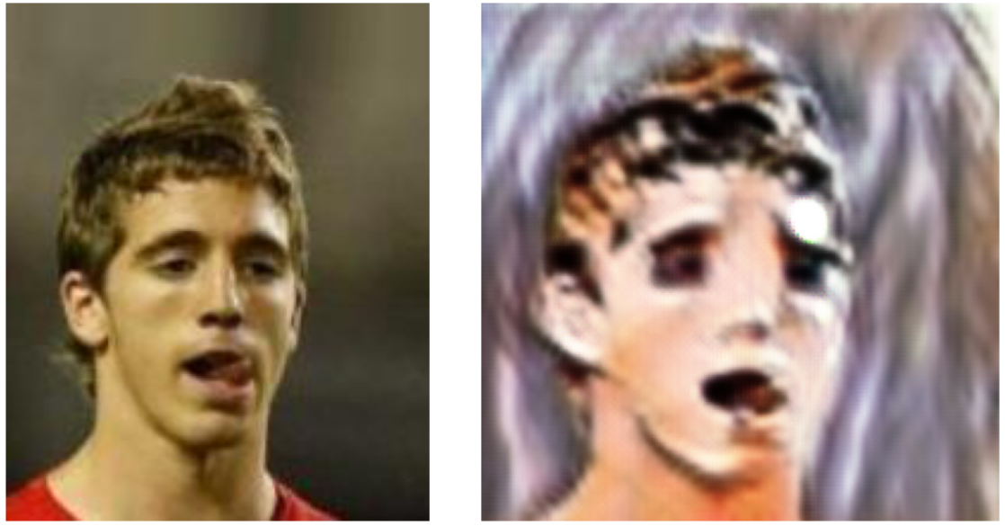
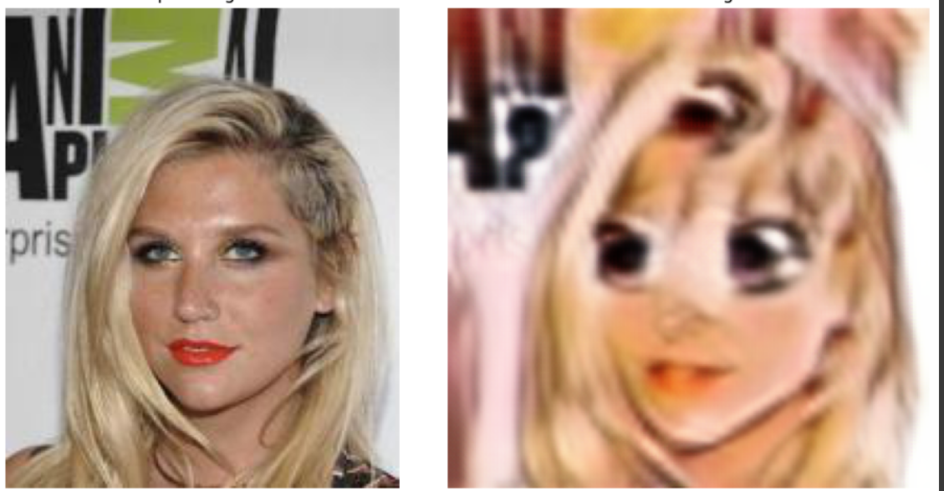
Our results

Slide 24
5
Conclusion

Slide 25
Cartoonization applications range from publication in printed media to storytelling for children's education.
We want to create a Deep Learning model that can convert real world images into cartoons.

Slide 26
6
Future Work

Slide 27
Generalizing The Model
Drawbacks:
Our present implementation only trained on facial data.
The model is also trained for less epochs - 18 epochs.
Plan:
To train model on large datasets containing not only faces but full length pics, landscapes, multiple people in a single image etc
Train our GAN for larger epochs (100), Commonly, GANs are trained for several hundred to a few thousand epochs. For example:
In the original GAN paper by Goodfellow et al., the authors trained the GANs for 25,000 epochs (iterations) on the MNIST dataset.
In the CycleGAN paper by Zhu et al., the authors trained the model for 200 epochs on various datasets, such as horse-to-zebra translation and style transfer tasks.

Slide 28
Resources
Jun-Yan Zhu, Taesung Park, Phillip Isola, and Alexei A. Efros, "Unpaired Image-to-Image Translation using Cycle-Consistent Adversarial Networks", 2017.
PyTorch documentation: PyTorch official website: https://pytorch.org/
Chen, Yang, Yu-Kun Lai, and Yong-Jin Liu. "Cartoongan: Generative adversarial networks for photo cartoonization." Proceedings of the IEEE conference on computer vision and pattern recognition. 2018.
L. Wang, W. Chen, W. Yang, F. Bi and F. R. Yu, "A State-of-the-Art Review on Image Synthesis With Generative Adversarial Networks," in IEEE Access, vol. 8, pp. 63514-63537, 2020, doi: 10.1109/ACCESS.2020.2982224.

Slide 29
Thanks!

